Slide 1
What Actually Explains
Life Expectancy
A Global Health Data Story · 215 countries and territories, 2000–2023
Katelyn Rakonjac | 17:610:554 Information Visualization & Presentation | Term Project

Slide 2
THE QUESTION
Which variables actually move life expectancy,
and which just ride along with wealth?
215
countries & territories
Life expectancy is the number news stories use to sum up a country's health. But it's really the output of a bunch of quieter variables working together: healthcare spending, physician supply, national wealth, chronic disease, tobacco use. This project tests each one against 23 years of real data instead of assuming which ones matter.
24
years of data (2000-2023)
7
variables tested

Slide 3
APPROACH TAKEN
Built on Vis 2, revised against the professor's feedback
Diverging color, not sequential
Animated by year
1
Map recolored: orange-blue diverging palette, custom midpoint at 70 years.
2
Added Year to the map's Pages shelf so it plays 2000 → 2023, like the motion charts.
A third variable, tested first
One trend line, not seven
3
Tried a few candidates with a trend line, then added Physicians per 1,000, the tightest fit of the group.
4
Unchecked Region as a trend-line factor so each chart shows one overall line.
Two dashboards, cross-highlighted
5
Map + charts paired with Highlight Actions set to All Fields.

Slide 4
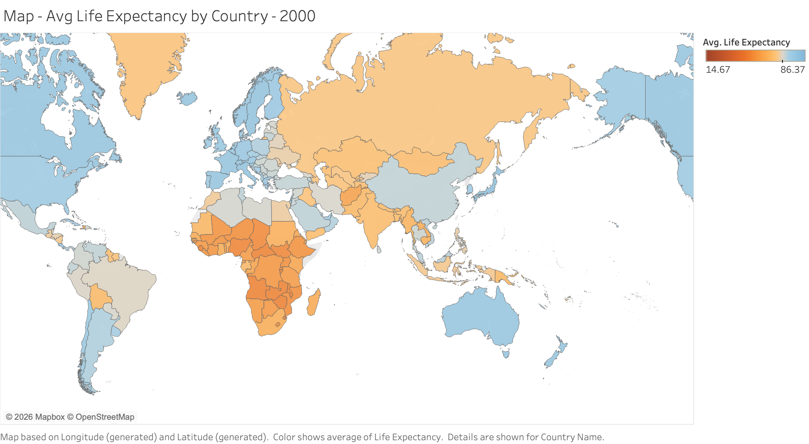
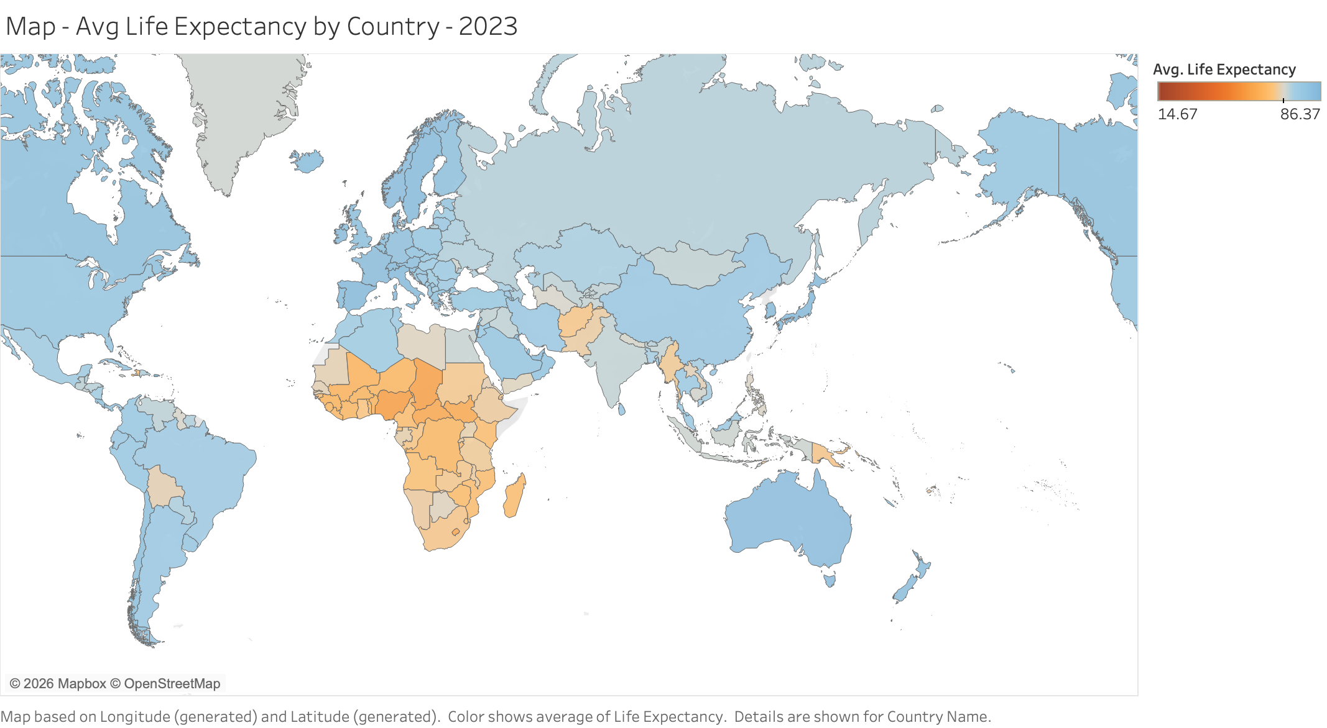
VISUALIZATION 1 · THE MAP
A 23-year gap that's slowly closing
2000
2023
READING THE MAP
Orange is below the 70-year midpoint, blue is above it. Most of South and Southeast Asia crosses into blue by 2023. Sub-Saharan Africa is the one region that mostly hasn't. A sequential scale would have hidden this; it would just look like a lighter shade of the same color.

Slide 5
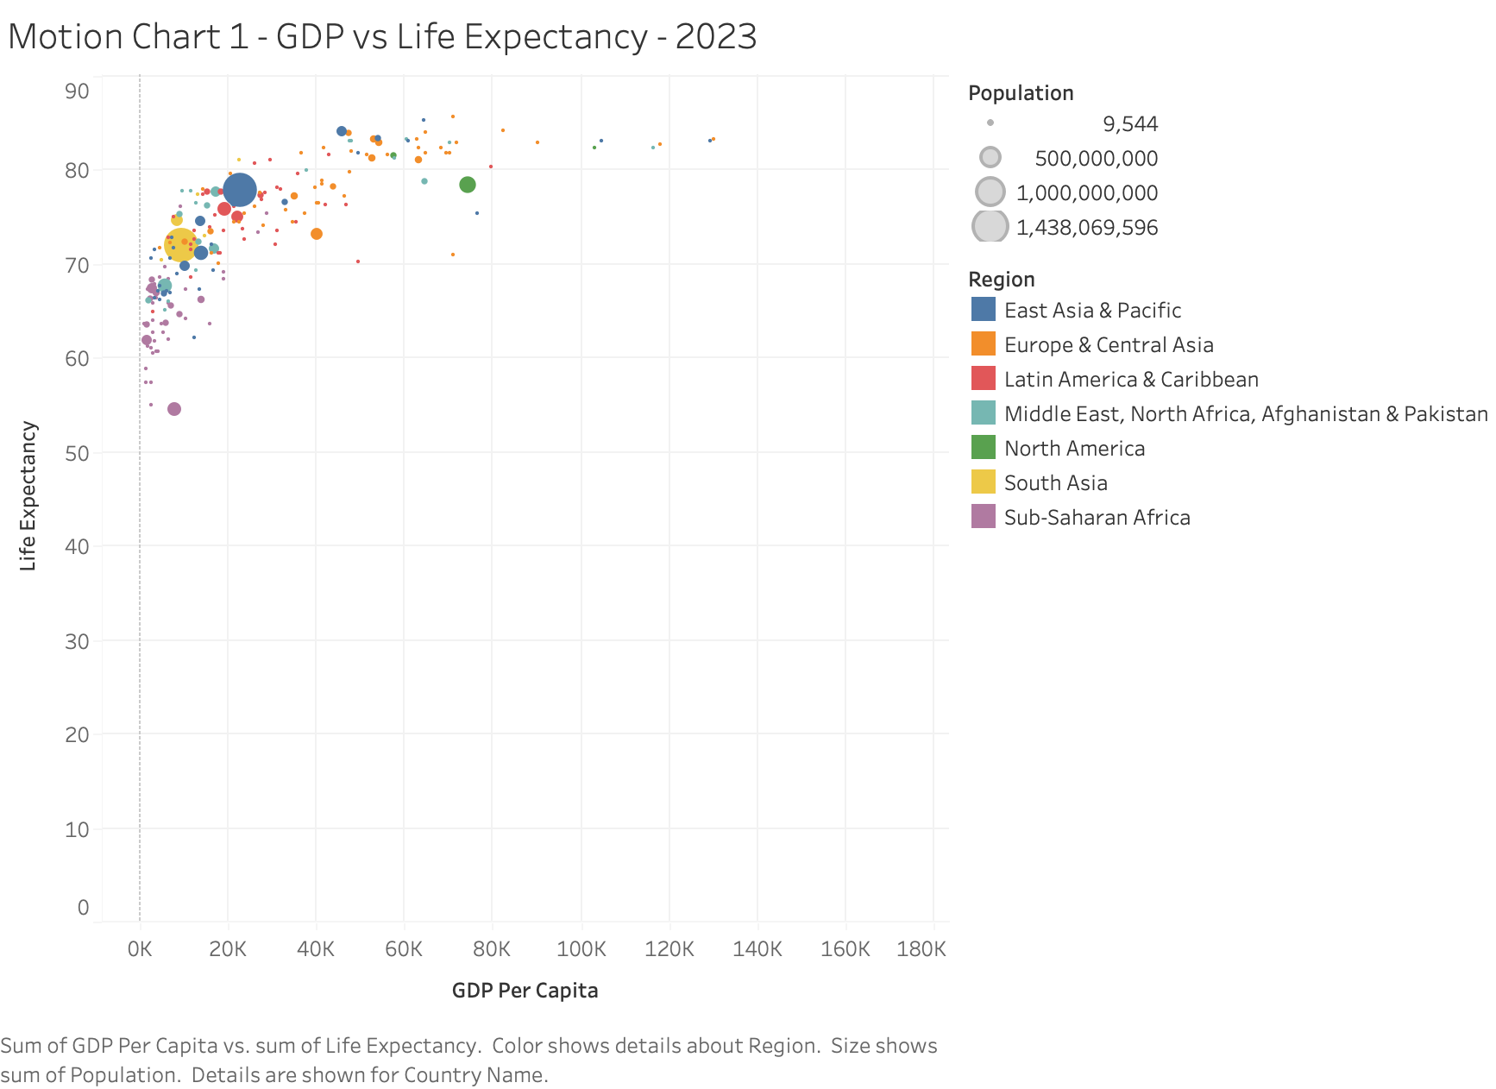
VISUALIZATION 2 · MOTION CHART
GDP per capita: strong, but not a straight line
THE PATTERN
GDP per capita and life expectancy clearly move together, but not in a straight line. The scatter curves, it doesn't run straight.
WHAT IT MEANS
Life expectancy climbs steeply from $0 to $20K per capita, then flattens. Nations above roughly $40K cluster near 80 to 85 years no matter how much richer they get from there. Classic diminishing returns.

Slide 6
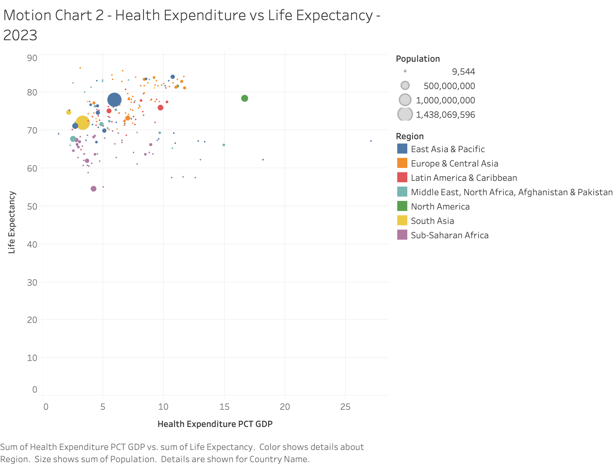
VISUALIZATION 3 · MOTION CHART
Health spending share: necessary, not sufficient
THE PATTERN
The messiest relationship of everything I looked at, barely any consistent pattern.
WHAT IT MEANS
Some countries spend 15 to 20% of GDP on health and still sit in the 60s and 70s. Others spend under 5% and land above 75. Spending share alone doesn't say whether that money is spent well.

Slide 7
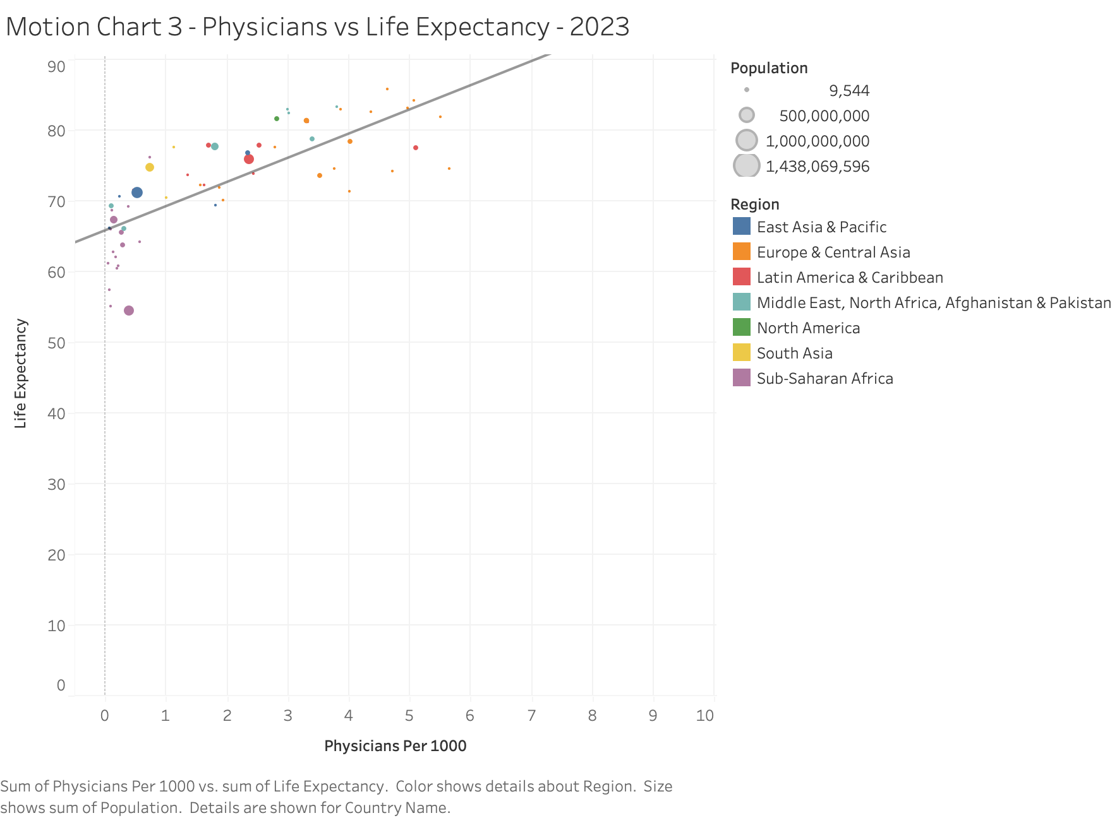
VISUALIZATION 4 · MOTION CHART (ADDED)
Physicians per 1,000: the stronger, quieter driver
THE PATTERN
Tracks life expectancy far more closely than health-expenditure share does. Points sit much tighter around the trend line than they did on the spending chart.
WHY IT MATTERS
Chosen after testing candidates instead of guessing. Next to the spending-share slide, it suggests how a country spends on healthcare, building out its physician workforce, matters more than how much it spends as a percent of GDP.

Slide 8
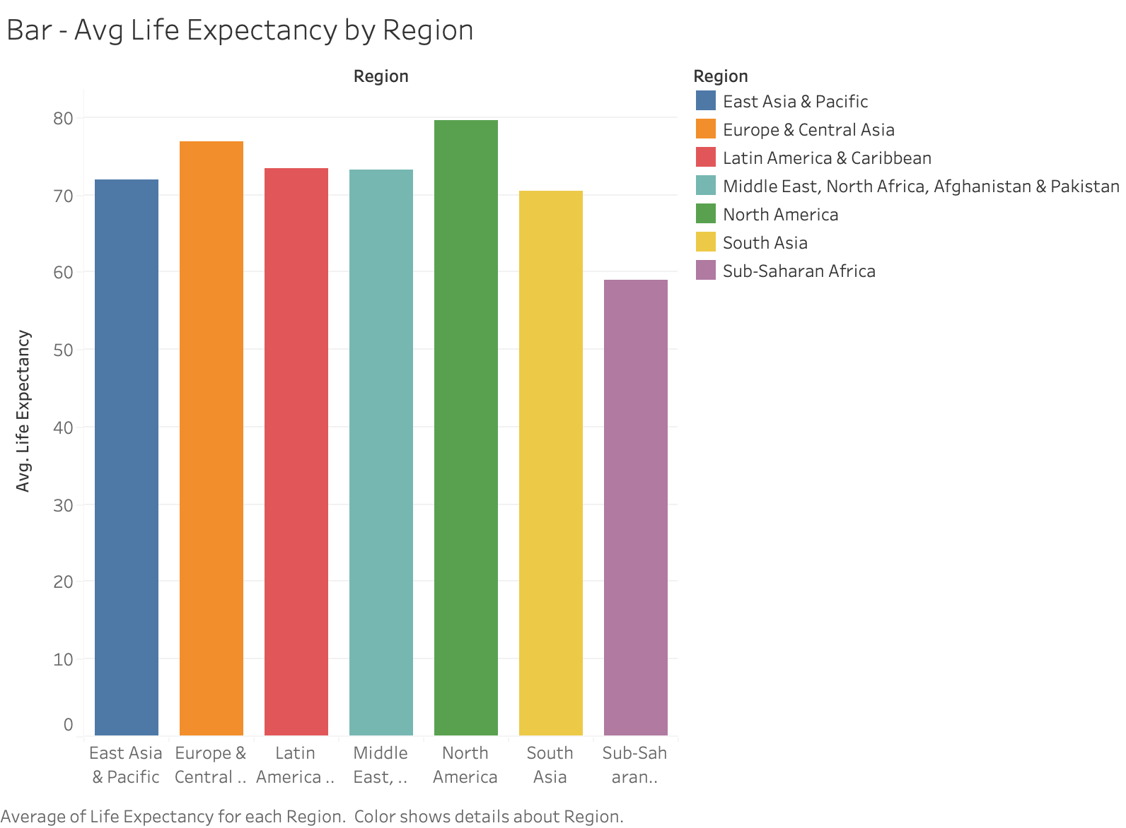
VISUALIZATION 5 · REGIONAL COMPARISON
The regional gap, in one bar chart
58.97
Sub-Saharan Africa (lowest)
79.63
North America (highest)
20.7 yrs
gap between them
At the country level in 2023: Monaco (86.4), San Marino (85.7) and Hong Kong (85.2) lead; Nigeria (54.5), Chad (55.1) and Lesotho (57.4) trail. That's a spread of about 32 years in a single year.

Slide 9
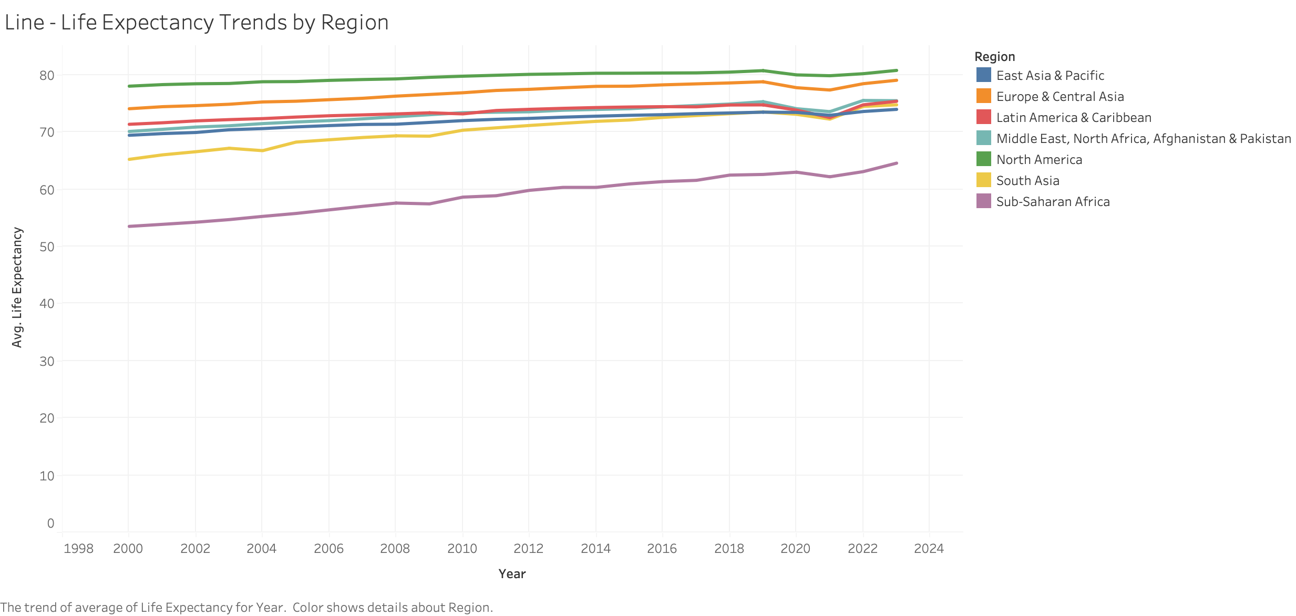
VISUALIZATION 6 · TREND OVER TIME
Steady progress, then a visible dip
READING THE TREND
Global average life expectancy rose from 67.6 years in 2000 to 73.8 in 2023. It's not a straight climb though. Nearly every region dips between 2019 and 2021 (global average fell from 73.0 to 71.8) before recovering by 2022 and 2023, timing that lines up with COVID.

Slide 10
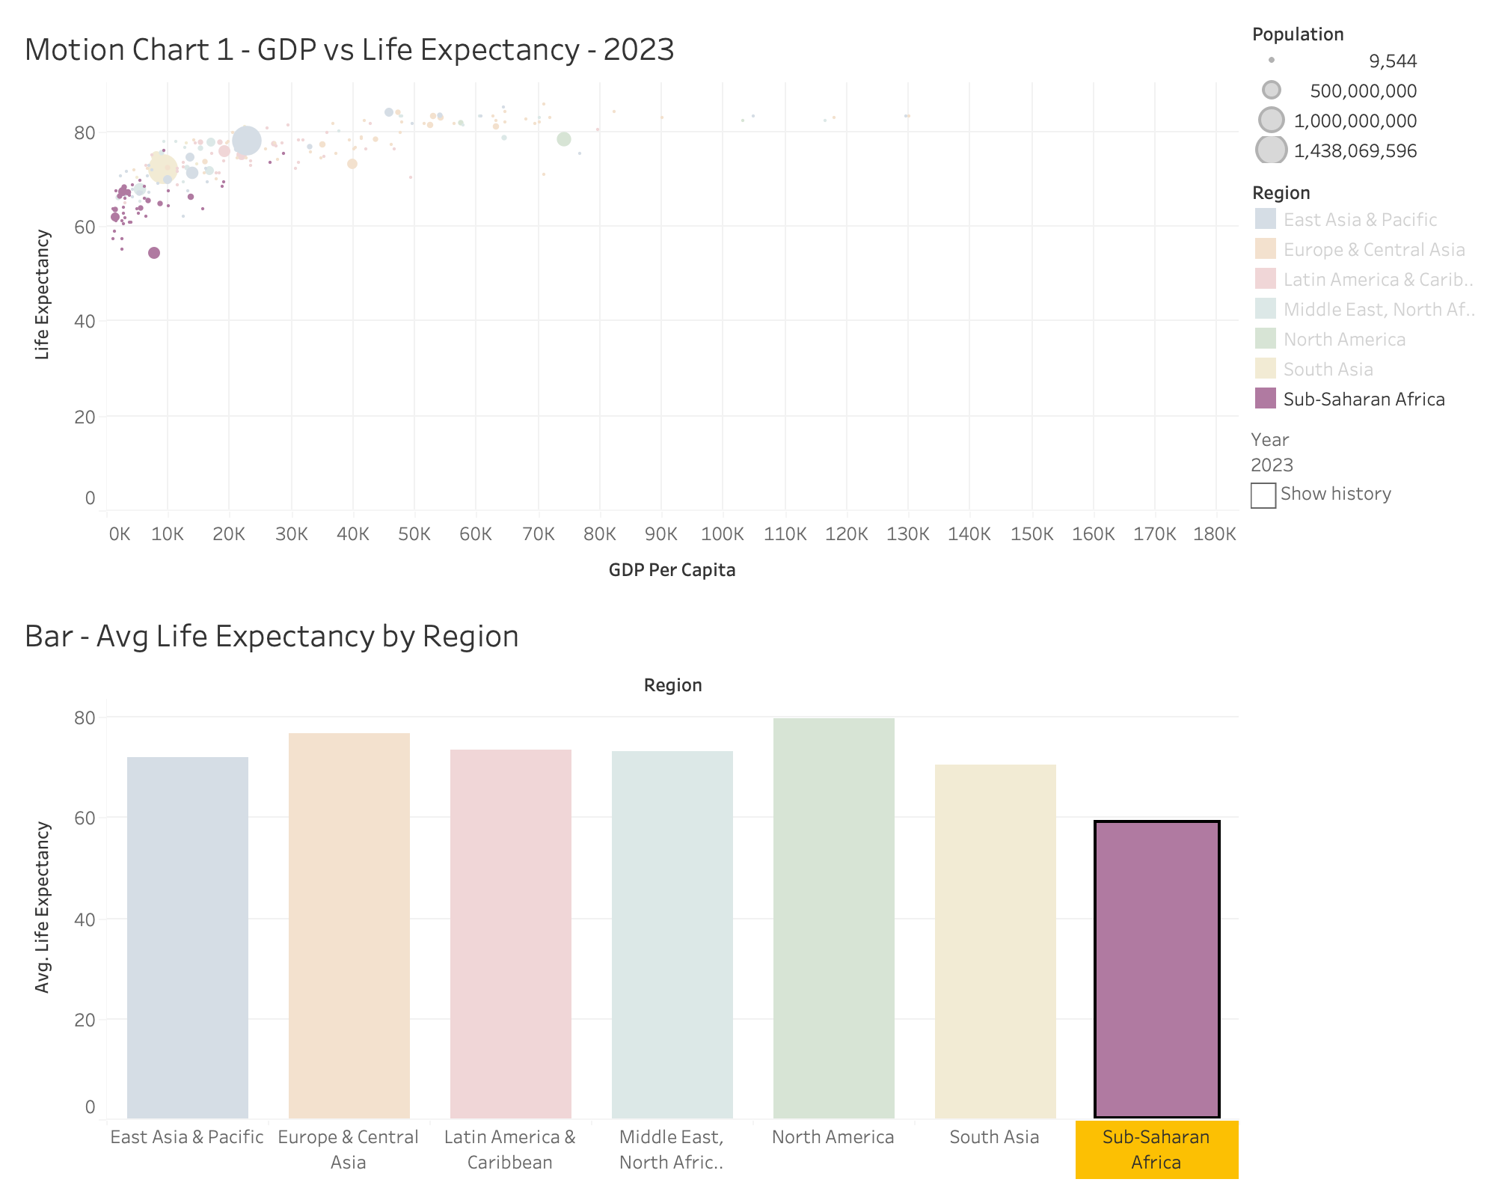
DASHBOARD 1
Wealth and Regional Comparison
HOW IT'S USED
Motion Chart 1 (GDP vs. life expectancy) paired with the regional bar chart. Press play on the Year control and the bubble cloud sweeps upward and right over 23 years.
Click any bubble and its region highlights in the bar chart below. Highlighting is set to All Fields, so the link between one country and its regional average is one click away.

Slide 11
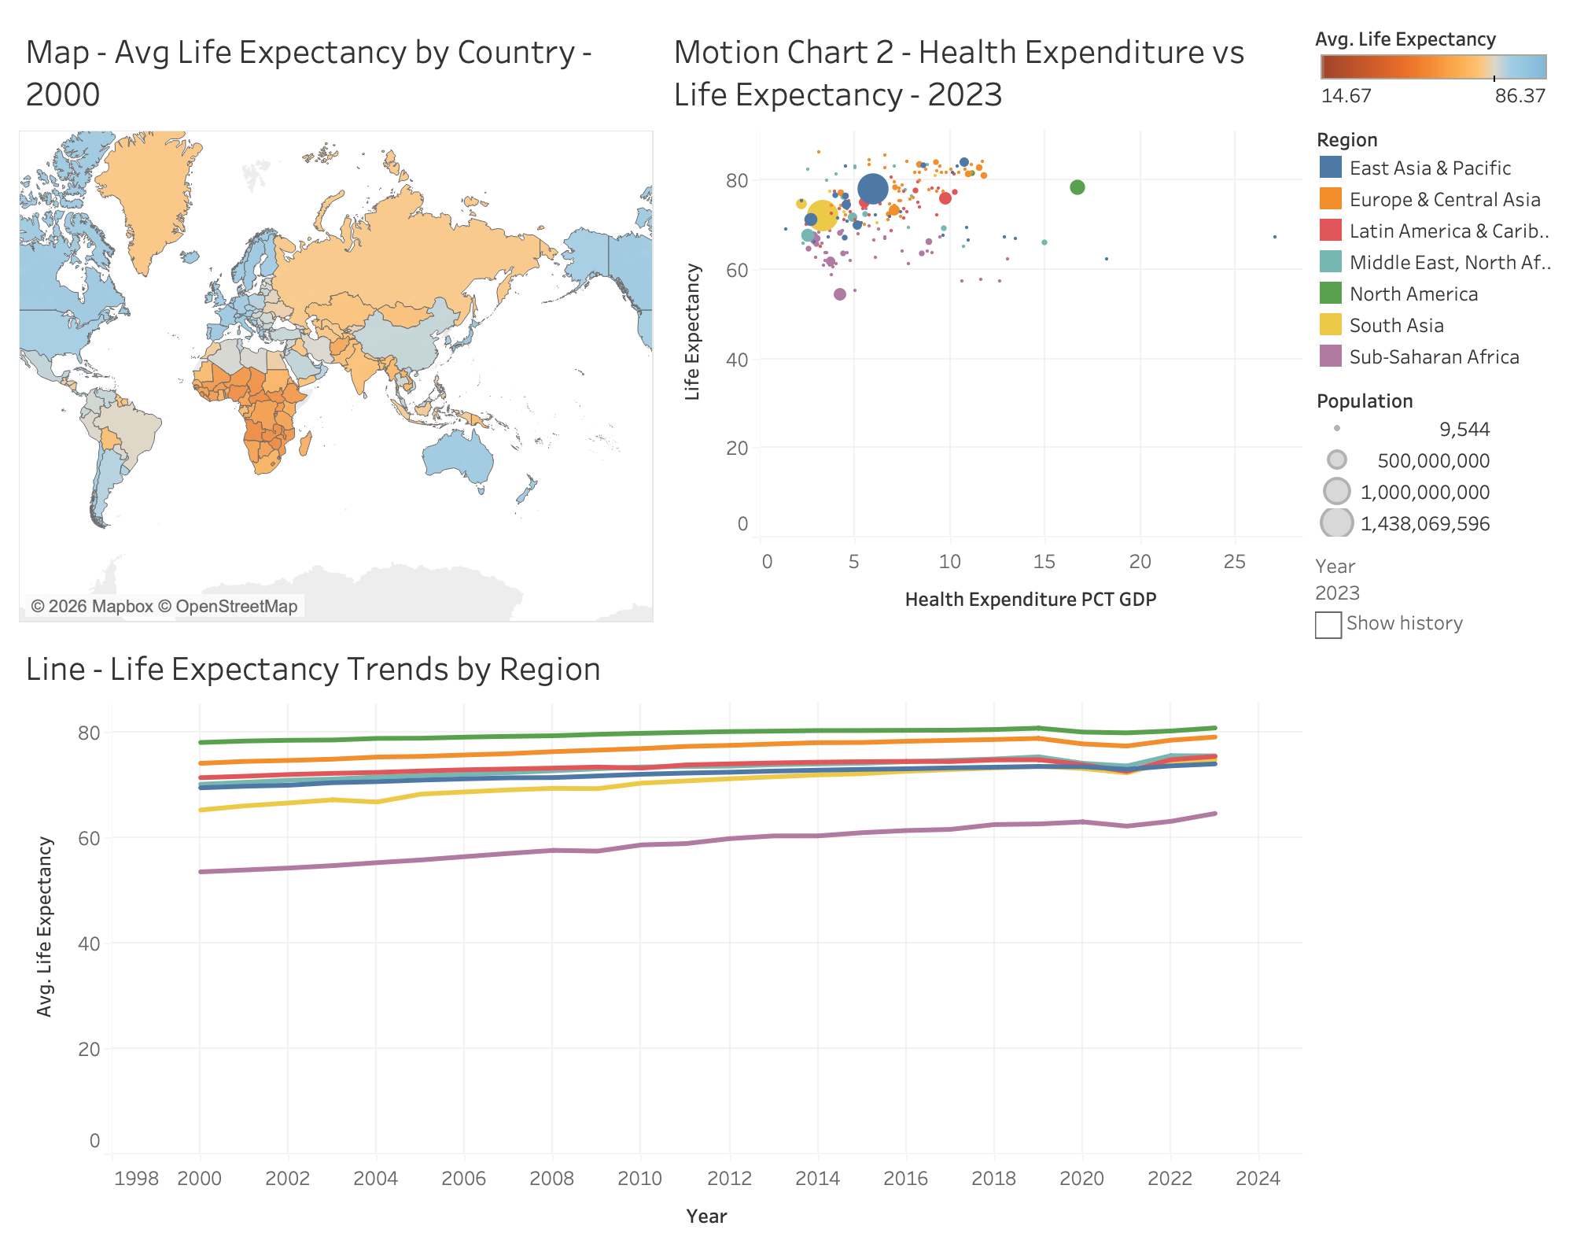
DASHBOARD 2
Geography, Spending, and Time
READING THE VIEW
The map, the health-expenditure motion chart, and the 23-year trend line, cross-highlighted together.
Click a country on the map to see how its spending compares to neighbors and where its region's trend line sits. Each view keeps its own Year control, since Tableau animates the Pages shelf per worksheet, but one click still ties all three together.

Slide 12
INSIGHTS GAINED
What the dashboards changed about the conclusions
Relationships
Outliers
Physicians per 1,000 and GDP per capita both tracked life expectancy closely across the motion charts. Health-expenditure share was the weakest link of the three, even though it's the one that comes up most in policy debates.
A handful of high-population, mid-expectancy countries pull the global picture toward the middle even while smaller wealthy nations cluster near the top.
Trends
Geography
Progress isn't a straight line up. The 2019-2021 dip across nearly every region is a reminder that a decades-long upward trend can still carry a real reversal.
The animated, diverging map makes Sub-Saharan Africa's stall obvious in a way the regional average (58.97 years) alone doesn't really convey.

Slide 13
CONCLUSION
No single variable explains life expectancy,
but the data does rank the candidates.
Healthcare workforce capacity and overall wealth matter more than raw spending share. Geography still tracks pretty closely with income twenty years into the century. And a clear long-term upward trend can still carry a real dip inside it. Building this as dashboards instead of six separate charts is what made comparisons like GDP against expenditure, or one region against another, something I could actually click through rather than just describe.

